Slide 1
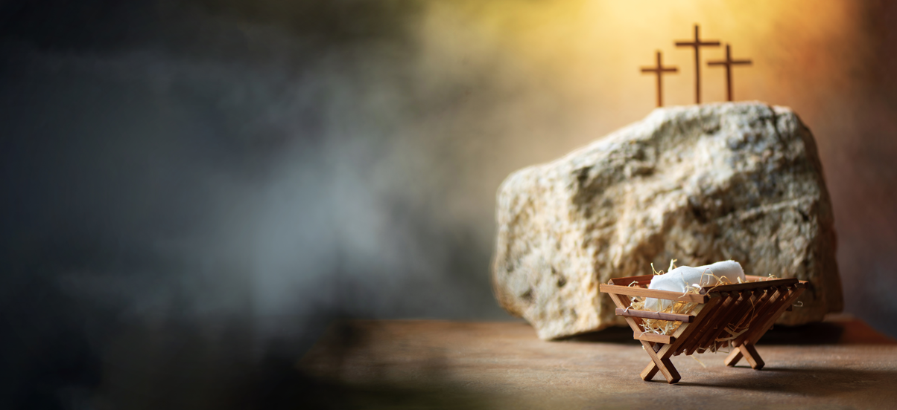
What Did Jesus
Say About
Christmas?
Matthew 17:1-5
Notes:
Stuart Fain ~ December 14, 2025 (AM)

Slide 2
Matthew 17:1-5 (NKJV)
¹ Now after six days Jesus took Peter, James, and John his brother, led them up on a high mountain by themselves; ² and He was transfigured before them. His face shone like the sun, and His clothes became as white as the light.

Slide 3
Matthew 17:1-5 (NKJV)
³ And behold, Moses and Elijah appeared to them, talking with Him.

Slide 4
Luke 9:30-31 (NAS)
³⁰ And behold, two men were talking with Him; and they were Moses and Elijah, ³¹ who, appearing in glory, were speaking of His departure, which He was about to accomplish at Jerusalem.

Slide 5
Matthew 17:1-5 (NKJV)
⁴ Then Peter answered and said to Jesus, "Lord, it is good for us to be here; if You wish, let us make here three tabernacles: one for You, one for Moses, and one for Elijah."

Slide 6
Matthew 17:1-5 (NKJV)
⁵ While he was still speaking, behold, a bright cloud overshadowed them; and suddenly a voice came out of the cloud, saying, "This is My beloved Son, in whom I am well pleased. Hear Him!"

Slide 7
What About Jesus & Christmas?
What Did Jesus Say About the Bible?
What Did Jesus Say About Worship?
What Do the Scriptures Say About Idolatry?
What Did Jesus Say Remembers Him?

Slide 8
Point #1: What Did Jesus Say About the Bible?
Hebrews 13:8 (NAS)
John 12:48 (KJV)
Revelation 22:7 (ASV)
Matthew 22:29 (NKJV)

Slide 9
Hebrews 13:8 (NASB)
Jesus Christ is the same yesterday and today, and forever

Slide 10
John 12:48 (KJV)
He that rejecteth me, and receiveth not my words, hath one that judgeth him: the word that I have spoken, the same shall judge him in the last day.

Slide 11
Revelation 22:7 (ASV)
And behold, I am coming quickly. Blessed is the one who keeps the words of the prophecy of this book.

Slide 12
Matthew 22:29 (NKJV)
Jesus answered and said to them, “You are mistaken, not knowing the Scriptures, nor the power of God.”

Slide 13
Point #2: What Did Jesus Say About Worship?
John 4:24 (KJV)
Mark 7:6-9 (NASB)

Slide 14
John 4:24 (KJV)
"God is spirit, and those who worship Him must worship in spirit and truth."

Slide 15
John 17:17 (NASB)
Sanctify them in the truth;
Your word is truth.

Slide 16
Mark 7:6-9 (NASB)
⁶ But He said to them, "Rightly did Isaiah prophesy about you hypocrites, as it is written: 'THIS PEOPLE HONORS ME WITH THEIR LIPS, BUT THEIR HEART IS FAR AWAY FROM ME.

Slide 17
Mark 7:6-9 (NASB)
⁷ 'AND IN VAIN DO THEY WORSHIP ME, TEACHING AS DOCTRINES THE COMMANDMENTS OF MEN.' ⁸ "Neglecting the commandment of God, you hold to the tradition of men."

Slide 18
Point #3: What Do the Scriptures Say About Idolatry?
I Corinthians 10:13-14 (NASB)
Colossians 3:5 (NKJV)
Jerimiah 10:2-4 (NKJV)

Slide 19
I Corinthians 10:13-14 (NASB)
¹³﻿ No temptation has overtaken you except something common to mankind; and God is faithful, so He will not allow you to be tempted beyond what you are able,

Slide 20
I Corinthians 10:13-14 (NASB)
but with the temptation will provide the way of escape also, so that you will be able to endure it.
¹⁴ Therefore, my beloved, flee from idolatry.

Slide 21
Colossians 3:5 (NKJV)
Therefore put to death therefore your members which are on the earth: fornication, uncleanness, passion, evil desire, and covetousness, which is idolatry;

Slide 22
Jerimiah 10:2-4 (NKJV)
¹ Hear the word which the LORD speaks to you, O house of Israel. ² Thus says the LORD: "Do not learn the way of the Gentiles; Do not be dismayed at the signs of heaven, For the Gentiles are dismayed at them.

Slide 23
Jerimiah 10:2-4 (NKJV)
³ For the customs of the peoples are futile; For one cuts a tree from the forest, The work of the hands of the workman, with the ax.
⁴ They decorate it with silver and gold; They fasten it with nails and hammers So that it will not topple.

Slide 24
Point #4: What Did Jesus Say Remembers Him?
I Corinthians 11:23-26 (KJV)
Revelation 22:16-20 (KJV)

Slide 25
I Corinthians 11:23-26 (KJV)
For I have received of the Lord that which also I delivered unto you, That the Lord Jesus the same night in which he was betrayed took bread: And when he had given thanks, he brake it, and said, Take, eat: this is my body, which is broken for you:

Slide 26
I Corinthians 11:23-26 (KJV)
this do in remembrance of me. After the same manner also he took the cup, when he had supped, saying, This cup is the new testament in my blood: this do ye, as oft as ye drink it, in remembrance of me.

Slide 27
I Corinthians 11:23-26 (KJV)
For as often as ye eat this bread, and drink this cup, ye do shew the Lord’s death till he come.

Slide 28
Revelation 22:16-20 (KJV)
¹⁶ I Jesus have sent mine angel to testify unto you these things in the churches. I am the root and the offspring of David, and the bright and morning star.

Slide 29
Revelation 22:16-20 (KJV)
¹⁷ And the Spirit and the bride say, Come. And let him that heareth say, Come. And let him that is athirst come. And whosoever will, let him take the water of life freely.

Slide 30
Revelation 22:16-20 (KJV)
¹⁸ For I testify unto every man that heareth the words of the prophecy of this book, If any man shall add unto these things, God shall add unto him the plagues that are written in this book:

Slide 31
Revelation 22:16-20 (KJV)
¹⁹ And if any man shall take away from the words of the book of this prophecy, God shall take away his part out of the book of life, and out of the holy city, and from the things which are written in this book.

Slide 32
Revelation 22:16-20 (KJV)
²⁰ He which testifieth these things saith, Surely I come quickly. Amen. Even so, come, Lord Jesus.

Slide 33

…that Christ died for our sins according to the scriptures;
And that he was buried, and that he rose again the third day according to the scriptures:

Slide 34
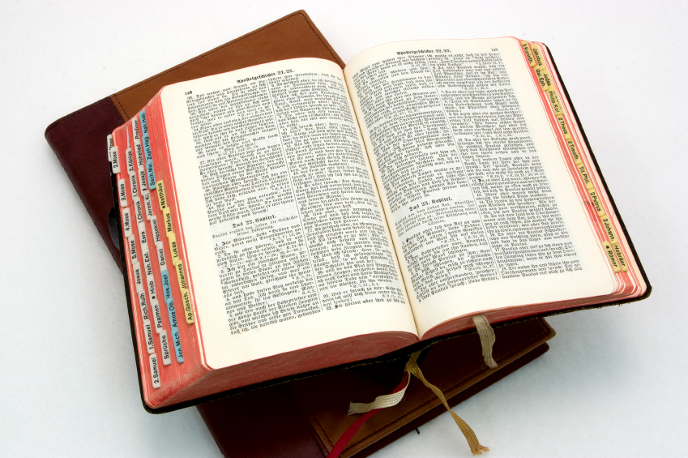
Hear: Romans 10:17
So then faith cometh by hearing, and hearing by the word of God.

Slide 35
Believe: Hebrews 11:6
But without faith it is impossible to please him: for he that cometh to God must believe that he is, and that he is a rewarder of them that diligently seek him.

Slide 36
Repent: Luke 13:3
I tell you, Nay: but, except ye repent, ye shall all likewise perish.

Slide 37
Confess: Matthew 10:32-33
32 Whosoever therefore shall confess me before men, him will I confess also before my Father which is in heaven.
33 But whosoever shall deny me before men, him will I also deny before my Father which is in heaven.

Slide 38
Baptize: Acts 22:16
And now why tarriest thou? arise, and be baptized, and wash away thy sins, calling on the name of the Lord.

